Slide 1

CSE310: Programming in Java
Topic: Java Platform Overview
By
Arvind Kumar
Asst. Professor, LPU

Slide 2
Outlines
Introduction
Why Java?
Where it is used?
Characteristics of Java
Java Platform Editions
Evolution of Java
Understanding JDK, JRE and JVM
How Java is platform-independent
Evaluating Java libraries, middle-ware, and database options

Slide 3
Procedural Programming Languages
Many early programming languages followed a paradigm called Procedural Programming.
These languages use a sequential pattern of program execution.
Drawbacks to procedural programming:
  – Difficult to translate real-world use cases to a sequential pattern
  – Difficult to maintain programs
  – Difficult to enhance as needed

Slide 4
Blank

Slide 5
JAVA
Java is a general purpose object-oriented programming language.
Java is a high level, robust, secured and platform independent.
Developed by Sun Microsystems (James Gosling).
Platform: Any hardware or software environment in which a program runs, is known as a platform.
Notes:
Object-oriented programming (OOP) is a programming paradigm based on the concept of "objects", which may contain data, in the form of fields, often known as attributes; and code, in the form of procedures, often known as methods.
There is only one pure object-oriented programming language and that’s Smalltalk.

Slide 6
Blank

Slide 7
Why Java?
Java is the Internet programming language.
Java enables users to develop and deploy applications on the Internet for servers, desktop computers, and small hand-held devices.

Slide 8
Blank

Slide 9
Where it is Used?
According to Sun, 3 billion devices run java.
Desktop Applications such as acrobat reader, media player, antivirus etc.
Web Applications such as irctc.co.in, javatpoint.com etc.
Enterprise Applications such as banking applications.
Mobile Applications
Embedded System, Smart Card, Robotics, Games etc.

Slide 10
Blank

Slide 11
Characteristics of Java
Java Is Simple
Java Is Object-Oriented
Java Is Distributed
Java Is Interpreted
Java Is Robust
Java Is Secure
Java Is Architecture-Neutral
Java Is Portable
Java's Performance
Java Is Multithreaded
Java Is Dynamic

Slide 12
Blank

Slide 13
Characteristics of Java
Java Is Simple
Java Is Object-Oriented
Java Is Distributed
Java Is Interpreted
Java Is Robust
Java Is Secure
Java Is Architecture-Neutral
Java Is Portable
Java's Performance
Java Is Multithreaded
Java Is Dynamic
Java is partially modeled on C++, but greatly simplified and improved. Some people refer to Java as "C++--" because it is like C++ but with more functionality and fewer negative aspects.

Slide 14
Blank

Slide 15
Characteristics of Java
Java Is Simple
Java Is Object-Oriented
Java Is Distributed
Java Is Interpreted
Java Is Robust
Java Is Secure
Java Is Architecture-Neutral
Java Is Portable
Java's Performance
Java Is Multithreaded
Java Is Dynamic
Java is inherently object-oriented. Although many object-oriented languages began strictly as procedural languages, Java was designed from the start to be object-oriented. Object-oriented programming (OOP) is a popular programming approach that is replacing traditional procedural programming techniques.
One of the central issues in software development is how to reuse code. Object-oriented programming provides great flexibility, modularity, clarity, and reusability through encapsulation, inheritance, and polymorphism.

Slide 16
Blank

Slide 17
Characteristics of Java
Java Is Simple
Java Is Object-Oriented
Java Is Distributed
Java Is Interpreted
Java Is Robust
Java Is Secure
Java Is Architecture-Neutral
Java Is Portable
Java's Performance
Java Is Multithreaded
Java Is Dynamic
Distributed computing involves several computers working together on a network. Java is designed to make distributed computing easy. Since networking capability is inherently integrated into Java, writing network programs is like sending and receiving data to and from a file.

Slide 18
Blank

Slide 19
Characteristics of Java
Java Is Simple
Java Is Object-Oriented
Java Is Distributed
Java Is Interpreted
Java Is Robust
Java Is Secure
Java Is Architecture-Neutral
Java Is Portable
Java's Performance
Java Is Multithreaded
Java Is Dynamic
You need an interpreter to run Java programs. The programs are compiled into the Java Virtual Machine code called bytecode. The bytecode is machine-independent and can run on any machine that has a Java interpreter, which is part of the Java Virtual Machine (JVM).

Slide 20
Blank

Slide 21
Characteristics of Java
Java Is Simple
Java Is Object-Oriented
Java Is Distributed
Java Is Interpreted
Java Is Robust
Java Is Secure
Java Is Architecture-Neutral
Java Is Portable
Java's Performance
Java Is Multithreaded
Java Is Dynamic
Java compilers can detect many problems that would first show up at execution time in other languages.
Java has eliminated certain types of error-prone programming constructs found in other languages.
Java has a runtime exception-handling feature to provide programming support for robustness.

Slide 22
Blank

Slide 23
Characteristics of Java
Java Is Simple
Java Is Object-Oriented
Java Is Distributed
Java Is Interpreted
Java Is Robust
Java Is Secure
Java Is Architecture-Neutral
Java Is Portable
Java's Performance
Java Is Multithreaded
Java Is Dynamic
No explicit pointer
Programs run inside virtual machine sandbox.

Slide 24
Blank

Slide 25
Characteristics of Java
Java Is Simple
Java Is Object-Oriented
Java Is Distributed
Java Is Interpreted
Java Is Robust
Java Is Secure
Java Is Architecture-Neutral
Java Is Portable
Java's Performance
Java Is Multithreaded
Java Is Dynamic
Write once, run anywhere
With a Java Virtual Machine (JVM), you can write one program that will run on any platform.

Slide 26
Blank

Slide 27
Characteristics of Java
Java Is Simple
Java Is Object-Oriented
Java Is Distributed
Java Is Interpreted
Java Is Robust
Java Is Secure
Java Is Architecture-Neutral
Java Is Portable
Java's Performance
Java Is Multithreaded
Java Is Dynamic
Because Java is architecture neutral, Java programs are portable. They can be run on any platform without being recompiled.

Slide 28
Blank

Slide 29
Characteristics of Java
Java Is Simple
Java Is Object-Oriented
Java Is Distributed
Java Is Interpreted
Java Is Robust
Java Is Secure
Java Is Architecture-Neutral
Java Is Portable
Java's Performance
Java Is Multithreaded
Java Is Dynamic
Java is faster than traditional interpretation since byte code is "close" to native code still somewhat slower than a compiled language (e.g., C++)

Slide 30
Blank

Slide 31
Characteristics of Java
Java Is Simple
Java Is Object-Oriented
Java Is Distributed
Java Is Interpreted
Java Is Robust
Java Is Secure
Java Is Architecture-Neutral
Java Is Portable
Java's Performance
Java Is Multithreaded
Java Is Dynamic
Multithread programming is smoothly integrated in Java, whereas in other languages you have to call procedures specific to the operating system to enable multithreading.

Slide 32
Blank

Slide 33
Characteristics of Java
Java Is Simple
Java Is Object-Oriented
Java Is Distributed
Java Is Interpreted
Java Is Robust
Java Is Secure
Java Is Architecture-Neutral
Java Is Portable
Java's Performance
Java Is Multithreaded
Java Is Dynamic
Java was designed to adapt to an evolving environment. New code can be loaded on the fly without recompilation. There is no need for developers to create, and for users to install, major new software versions. New features can be incorporated transparently as needed.

Slide 34
Blank

Slide 35
Java Platform Editions
A Java Platform Editions is the set of APIs, class libraries, and other programs used in developing Java programs for specific applications.
Notes:
Recognizing that one size doesn’t fit all, Sun has grouped its technologies into three editions.
Java 2 Platform, Standard Edition (J2SE)
The J2SE platform is a fast and secure foundation for building and deploying client-side enterprise applications. In today's .com world of nanosecond response times and information gratification, J2SE technology provides the speedy performance and high functionality that is demanded by Web users.
For end users, J2SE technology enables faster and easier use of functionally rich Web applications, such as corporate intranets and interactive shopping aids for e-commerce. For enterprise developers, the improved J2SE technology serves as the base tool for creating sophisticated, valuable applications that can be brought to market quickly.
Java 2 Platform, Enterprise Edition (J2EE)
J2EE technology simplifies enterprise applications by basing them on standardized, modular and re-usable components called Enterprise JavaBeans™ (EJB™), providing a complete set of services to those components, and handling many details of application behavior automatically. By automating many of the time-consuming and difficult tasks of application development, J2EE technology allows enterprise developers to focus on adding value, that is, enhancing business logic, rather than building infrastructure.
Java 2 Platform, Micro Edition (J2ME)
J2ME technology specifically addresses the vast consumer space, which covers the range of extremely tiny commodities such as smart cards or a pager all the way up to the set-top box, an appliance almost as powerful as a computer. J2ME technology enables device manufacturers, service providers, and content creators to gain a competitive advantage and capitalize on new revenue streams by rapidly and cost-effectively developing and deploying compelling new applications and services to their customers worldwide.
Each edition is a developer treasure chest of tools and supplies that can be used with a particular product.
Note that there are packages developed and supported by Sun that are not part of any edition such as (java3d for 3d graphics).

Slide 36
Blank

Slide 37
There are 3 Java Platform Editions
1. Java 2 Platform, Standard Edition (J2SE)
  Core Java Platform targeting applications running on workstations
2. Java 2 Platform, Enterprise Edition (J2EE)
  Component-based approach to developing distributed, multi-tier enterprise applications
3. Java 2 Platform, Micro Edition (J2ME)
  Targeted at small, stand-alone or connectable consumer and embedded devices

Slide 38
Blank

Slide 39
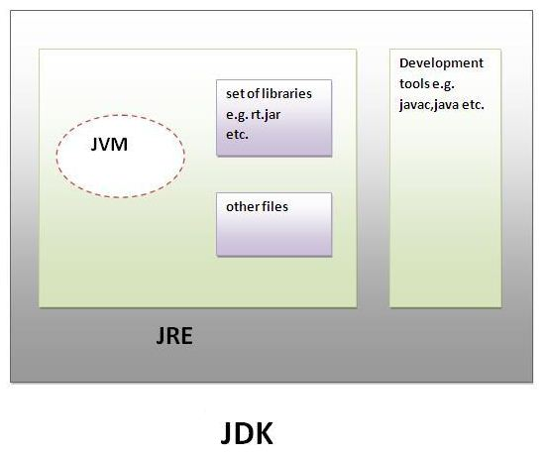
Understanding JDK, JRE and JVM

Slide 40
Blank

Slide 41
Understanding JDK & JRE
JDK
JDK is an acronym for Java Development Kit.
It physically exists. It contains JRE and development tools.
JRE
JRE is an acronym for Java Runtime Environment.
It is the implementation of JVM and used to provide runtime environment.
It contains set of libraries and other files that JVM uses at runtime.

Slide 42
Blank

Slide 43
Understanding JVM
JVM (Java Virtual Machine) is an abstract machine.
It is a specification that provides runtime environment in which java byte code can be executed.
JVMs are available for many hardware and software platforms.
The JVM performs following main tasks:
  Loads code
  Verifies code
  Executes code
  Provides runtime environment

Slide 44
Blank

Slide 45
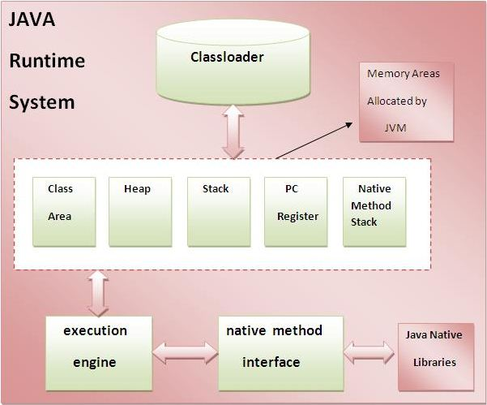
Internal Architecture of JVM

Slide 46
Blank

Slide 47

How Java is Platform-independent?

Slide 48
Blank

Slide 49
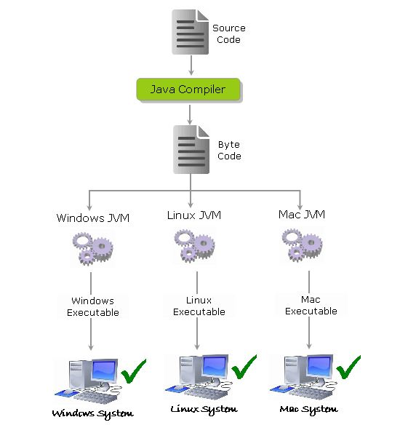
How Java is Platform-independent?

Slide 50
How Java is Platform-independent?
The source code (program) written in java is saved as a file with .java extension.
The java compiler “javac” compiles the source code and produces the platform independent intermediate code called BYTE CODE. It is a highly optimized set of instructions designed to be executed by the JVM.

Slide 51
Blank

Slide 52
How Java is Platform-independent?
The byte code is not native to any platform because java compiler doesn’t interact with the local platform while generating byte code.
It means that the Byte code generated on Windows is same as the byte code generated on Linux for the same java code.
The Byte code generated by the compiler would be saved as a file with .class extension. As it is not generated for any platform, can’t be directly executed on any CPU.

Slide 53
Blank

Slide 54
Java Libraries, Middle-ware, and Database options
java.lang
java.util
java.sql
java.io
java.nio
java.awt
javax.swing

Slide 55
Blank

Slide 56


